Slide 1
Input-Duration Effects on Wav2Vec2-base Speaker Identification – A VoxCeleb1 Study
EN.520.661.01 — AI and Biometric Systems: Techniques, Applications and Ethics
Dr. Najim Dehak & Dr. Thomas Thebaud
Notes:
Tip: If you want to update this template with your division or center logo, navigate to View > Slide Master and edit the template from there.

Slide 2
Table of Contents
Speaker Recognition and its Importance
Context
Scientific Questions
Motivation and Goals
Dataset
Methodology and Experimental Setup
Evaluation Metrics
Results
Computational Cost Analysis
Conclusions
Future Work
References

Slide 3
Speaker Recognition and its Importance

Slide 4
Identifying who is speaking based on their unique voice characteristics (Voice Biometrics)
It's a powerful biometric modality, increasingly used alongside or instead of passwords and other identifiers
Important applications include secure voice interfaces, personalized device interactions, contact center automation, and forensic analysis

Slide 5
Context

Slide 6
Wav2Vec 2.0, pre-trained on ASR tasks, has demonstrated strong generalization — but its potential for speaker identification is underexplored
Speaker recognition requires fixed-length inputs, yet real-world audio varies widely in duration. Systems often pad or truncate — but how much is enough
VoxCeleb1, a benchmark dataset of diverse speakers, reflects natural variability in speech — making it ideal to examine duration effects
Our work probes how input duration impacts performance and cost, building practical insights for deployment and model design

Slide 7
Scientific Questions

Slide 8
Q1: How much audio is sufficient for reliable speaker identification using Wav2Vec 2.0?
Q2: Does more audio always help — or can it introduce redundancy, noise, or overfitting?
Q3: What is the best trade-off between performance (EER, accuracy) and attention cost (FLOPs)?
These questions guide our empirical study — fine-tuning Wav2Vec 2.0 on VoxCeleb1 across 16 fixed durations, from 1 second to 69 seconds

Slide 9
Motivation and Goals

Slide 10
Measure how different input lengths affect Wav2Vec 2.0’s performance for speaker identification
Repurpose Wav2Vec 2.0’s robust acoustic features for speaker recognition — without task-specific pretraining
Identify durations that offer the best balance between accuracy, latency, and GPU cost — critical for real-time voice systems

Slide 11
Dataset

Slide 12
Codec-SUPERB/Voxceleb_1_test_original on HuggingFace
The dataset includes 40 diverse speakers recorded under varied acoustic conditions, simulating realistic telephony and conversational audio scenarios
16 fixed target lengths (1s → 69s) – 1, 2, 3, 3.96 (minimum), 4, 5, 6, 6.48 (median), 7, 8, 8.28 (mean), 10, 15, 30, 50, 69 (maximum) seconds ensure both short‑utterance and long‑context regimes are covered

Slide 13
Methodology and Experimental Setup

Slide 14
Fine-tuned the facebook/wav2vec2-base model by adding a classification head for speaker identification
Audio inputs were explicitly padded or truncated to fixed durations (target_length) before feature extraction
Trained for 20 epochs using the HuggingFace Trainer with an 80/20 train-test split, batch size of 32, AdamW optimizer, and a learning rate of 3e-5
Experiments were optimized for efficient use of an A100 GPU (40GB VRAM)
Experiments up to 15 seconds were conducted using full precision (FP32); for the final 3 longer durations, mixed precision with bfloat16 and batch size of 2 were used to mitigate out-of-memory (OOM) errors on the GPU

Slide 15
Evaluation Metrics

Slide 16
Equal Error Rate (EER): Primary indicator of verification performance — lower is better
Accuracy: Proportion of correctly identified speakers among all predictions
Recall: Model’s ability to consistently detect the correct speaker across trials
Attention Cost (FLOPs): Proxy for computational burden — scales quadratically with sequence length (L′²)
Cost–EER Product (Efficiency): A combined metric capturing both model performance and compute efficiency (EER × L′²) — lower implies better trade-off

Slide 17
Results

Slide 18
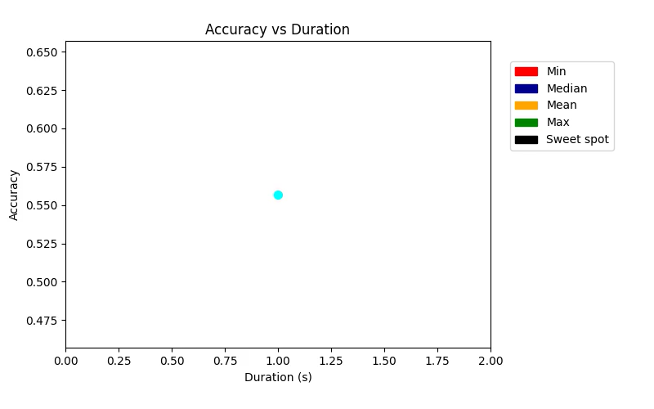
Sharp improvements from 1–4 seconds as EER drops from 0.122 to 0.0044, while accuracy jumps from 55.7% to 97.9%, suggesting Wav2Vec 2.0 can pick speaker cues even from short clips
There is a sweet spot between 5–8 seconds as this range delivers the best performance-efficiency tradeoff
At 8s, EER hits global minimum (0.000885), and accuracy peaks at 99%

Slide 19
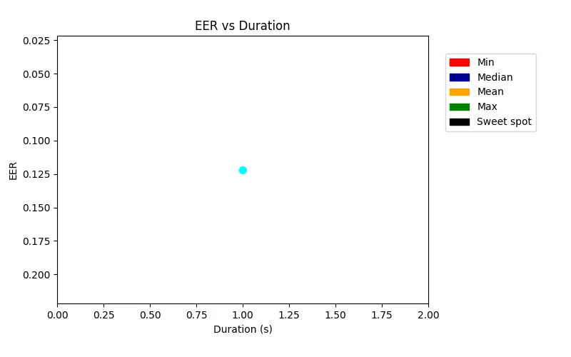
There is a degradation beyond 8 seconds as all metrics worsen from 10s to 69s
Longer input duration doesn’t mean better model accuracy and lower EER. This experiment demonstrates the contradiction to the belief that "more input = better"

Slide 20
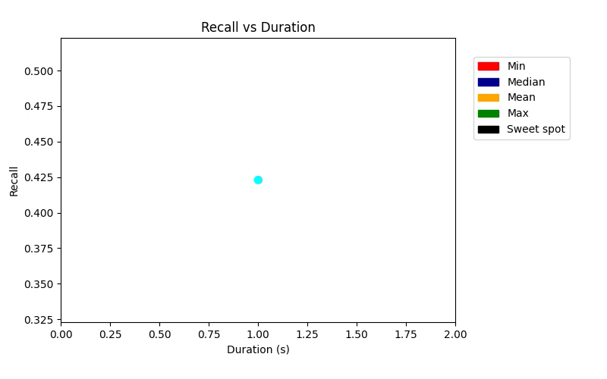
Speaker traits saturate early and ~6–8s clips are often enough
Ideal speaker recognition systems fine-tuned on Voxceleb1 should cap input to 6–8s for best generalization, latency, and resource use

Slide 21
Computational Cost Analysis

Slide 22
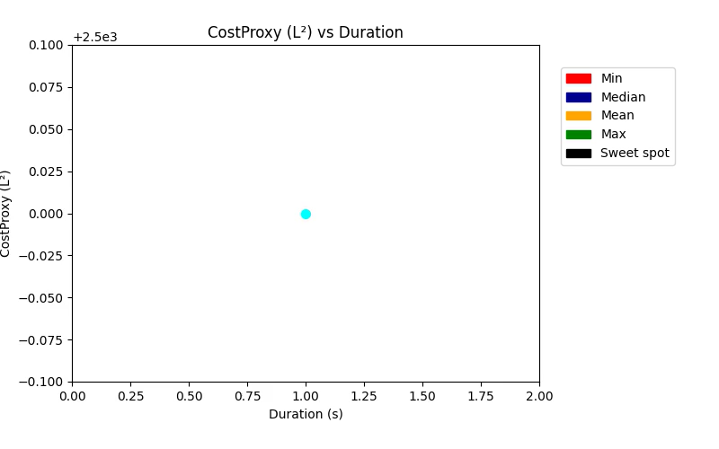
As sequence length grows linearly, attention FLOPs scale quadratically (1s → 2.5K units, 69s → 563K units)

Slide 23
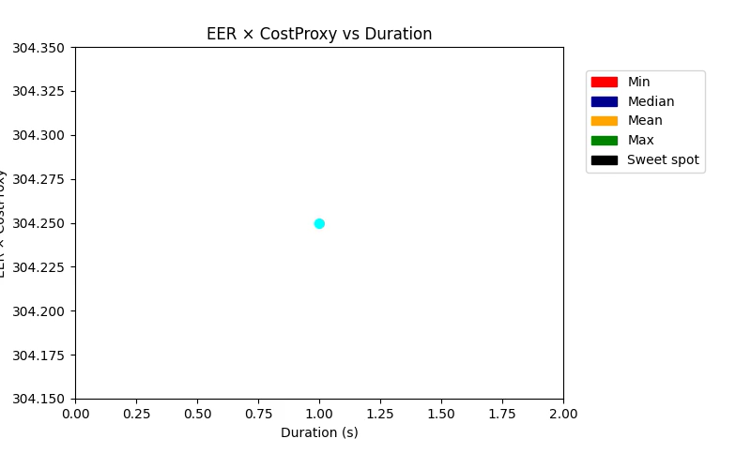
Lowest compute-per-accuracy cost appears at 5–8s
Longer durations get more expensive but less effective (5s → EER×Cost = 85, 69s → EER×Cost = 9510; 100× more cost for worse result)

Slide 24
Conclusion

Slide 25
Wav2Vec 2.0 achieves reliable speaker identification with just 3–4 seconds of audio; EER drops significantly from 0.122 at 1s to 0.0044 at 4s
Input durations between 5–8 seconds deliver the best performance–cost trade-off, with lowest EER, highest accuracy, and recall
Beyond 8 seconds, adding more input leads to diminishing and even negative returns in accuracy and EER, while computational cost rises steeply
Results suggest that useful speaker traits are captured early; longer inputs likely introduce redundancy or noise, degrading model performance
Trimming input audio to around 6–8 seconds provides optimal latency, accuracy, and compute efficiency for real-time speaker recognition systems

Slide 26
Future Work

Slide 27
Extend evaluation to VoxCeleb1-train and other multilingual or cross-domain datasets to assess generalizability of the results
Explore learnable or attention-based methods for selecting salient input segments instead of using fixed-length truncation or padding
Incorporate noise-aware or speaker-agnostic training objectives to reduce sensitivity to irrelevant segments in longer inputs
Investigate transformer modifications (e.g., sparse or long-range attention) that can better utilize long-context input without efficiency loss

Slide 28
References

Slide 29
Baevski, A., Zhou, Y., Xu, Y., & Auli, M. (2020). wav2vec 2.0: A framework for self-supervised learning of speech representations. Advances in Neural Information Processing Systems, 33, 12449-12460
Nagrani, A., Chung, J. S., Sluban, D., & Zisserman, A. (2017). VoxCeleb: a large-scale speaker identity dataset. arXiv preprint arXiv:1706.08619
Dehak, N., Kenny, P., Nouza, V., Castaldo, F., Matějka, P., Diez, M., Franco, F. (2011). Front-end factor analysis for speaker verification. IEEE Transactions on Audio, Speech, and Language Processing, 19(4), 747-757
Snyder, D., Chen, P., Povey, D., & Khudanpur, S. (2018). X-vectors: Robust DNN embeddings for speaker recognition. 2018 IEEE International Conference on Acoustics, Speech and Signal Processing (ICASSP), 4813-4817

Slide 30
Thank You!
Atharva Mokashi
MSE Data Science
amokash1@jh.edu
Notes:
Tip: There’s no need to include WWW or HTTPS in front of your URL.

